Slide 1
Water level forecasting for Tisza-river at Szeged
Data processing and ML-models
LSTM & CNN

Slide 2
Context
Paper 2023 by:
Zsolt Vizi, Bálint Batki, Luca Rátki, Szabolcs Szalánczi, István Fehérváry, Péter Kozák, Tímea Kiss
Water level prediction with various machine learning algorithms for a lowland river

Slide 3
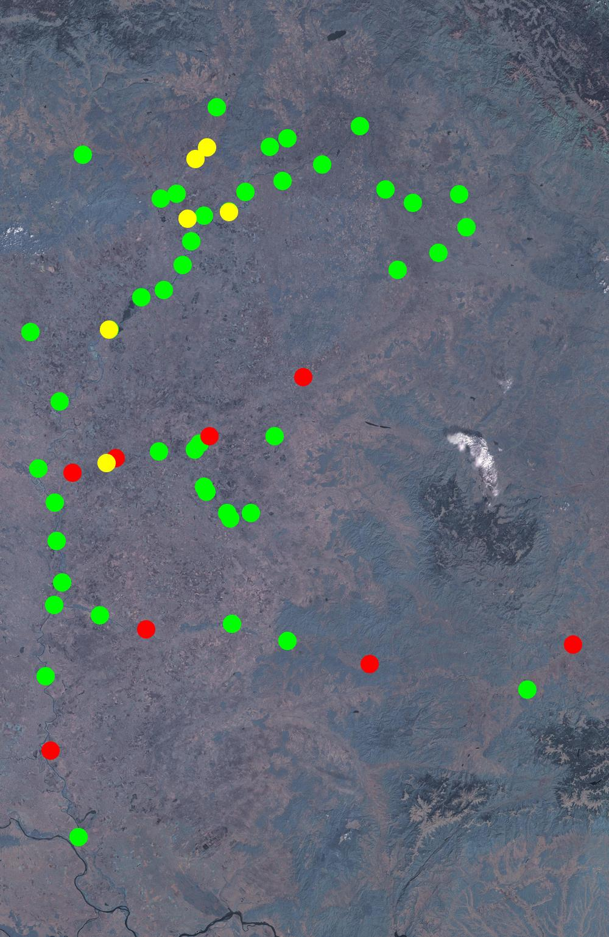
Flood Prediction
river changes
time
floods
dams

Slide 4
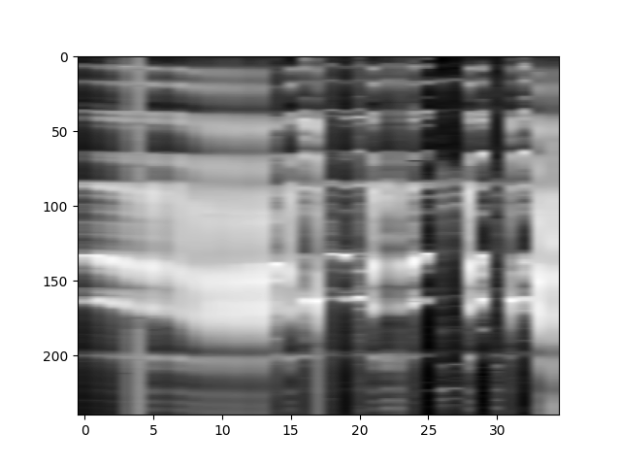
Data visualisation
WINTER
SPRING
Flood of 1970
SUMMER

Slide 5
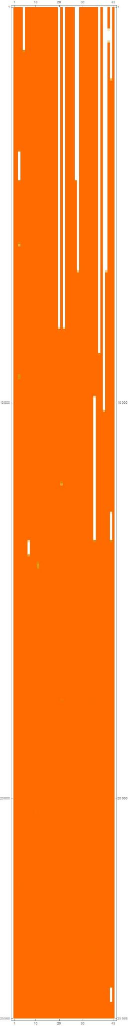
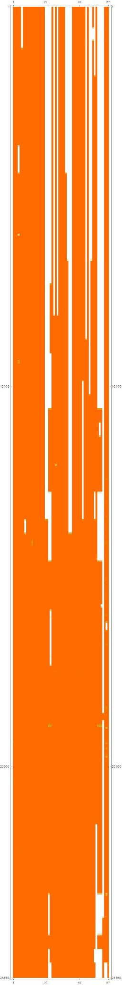
Data imputation
1951
daily measurements at 56 stations
filtering out stations with too incomplete data
using correlated stations to fill up missing patches
2020
56 GAUGE STATIONS
48 GAUGE STATIONS

Slide 6
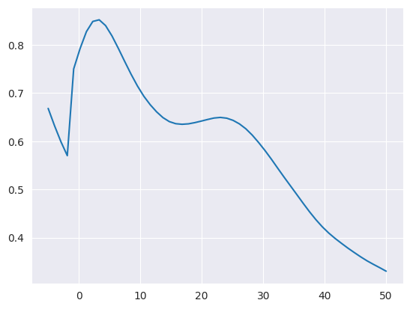
Further reducing stations
is a station to far away ?
cross correlation
causality tests
DAYS

Slide 7
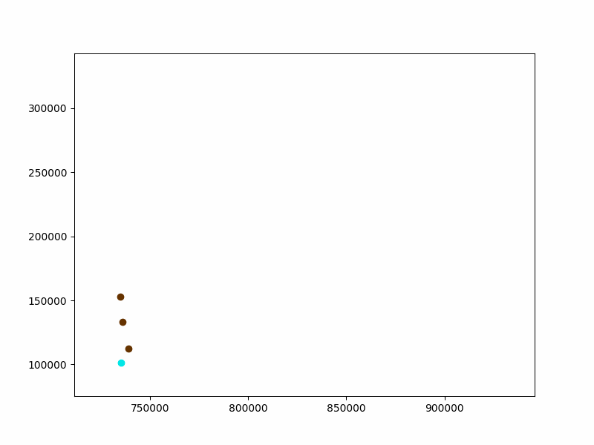
Correlation-lag between stations
1 frame = 1 day
all stations relevant

Slide 8

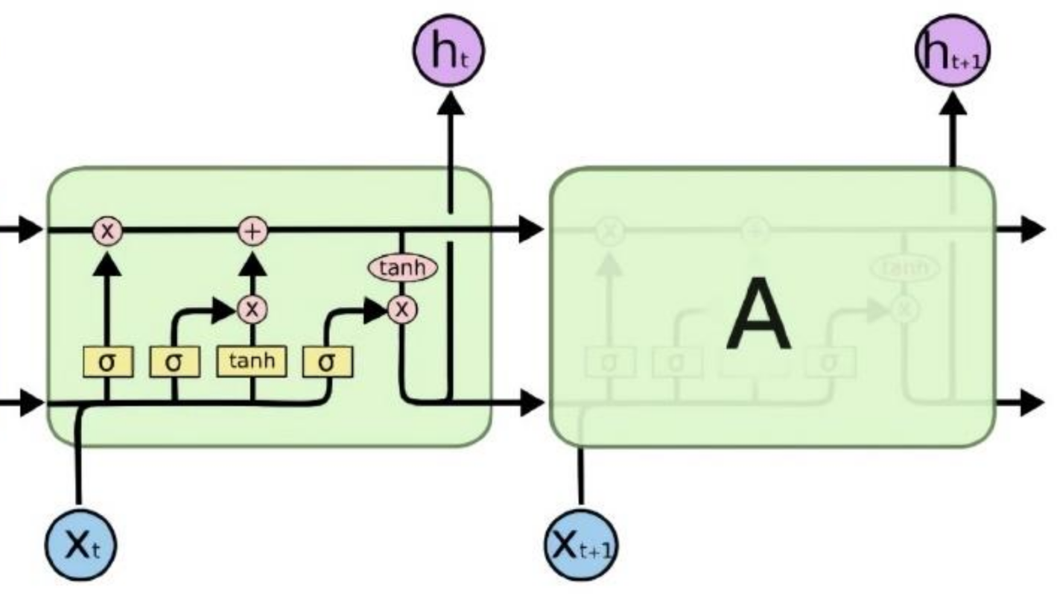
Model architectures
LSTM
CNN
Notes:
LSTM is a cell based recurrent neural network with a built in forget property in the cell.
CNN is a convolutional neural network, where the shared kernel slides along the given datas.

Slide 9
Model architectures
Regular CNN model
Day 1
Day 2
Day 3
Day 4
…
Day 15
Station 1 -1 Day | Szeged 0 Day | Station2 0 Day | Station 3 1 Day | Station 4 1 Day | Station 5 2 Days | Station 6 2 Days | … | Station 48 15 Days
1 | -3 | 2 | 1 | 4 | 4 | 5 | … | 6
2 | 5 | 1 | 2 | 7 | 4 | 8 | … | 5
3 | 5 | 6 | 8 | 9 | 5 | 6 | … | 7
2 | 7 | 5 | 4 | 5 | 6 | 4 | … | 2
… | … | … | … | … | … | … | … | …
4 | 3 | 4 | 6 | 3 | 5 | 1 | … | 9
Notes:
Let’s imagine the datas as a table, where the columns represent the stations and the rows are the days before the prediction. Inside the table the water level is stored. In the case of the CNN network we used a 1 dimensional convolution where all the stations are observed with the same kernel. As you can see in this animation.

Slide 10
Model architectures
CNN with spatial information
Day 1
Day 2
Day 3
Day 4
…
Day15
Station 1 -1 Day | Szeged 0 Day | Station2 0 Day | Station 3 1 Day | Station 4 1 Day | Station 5 2 Days | Station 6 2 Days | … | Station 48 15 Days
1 | -3 | 2 | 1 | 4 | 4 | 5 | … | 6
2 | 5 | 1 | 2 | 7 | 4 | 8 | … | 5
3 | 5 | 6 | 8 | 9 | 5 | 6 | … | 7
2 | 7 | 5 | 4 | 5 | 6 | 4 | … | 2
… | … | … | … | … | … | … | … | …
4 | 3 | 4 | 6 | 3 | 5 | 1 | … | 9
Notes:
To give more data for the network, we used another approach. At the beginning only the closest stations are examined by the network and after that in every further step the stations further and further away are also taken into consideration.

Slide 11
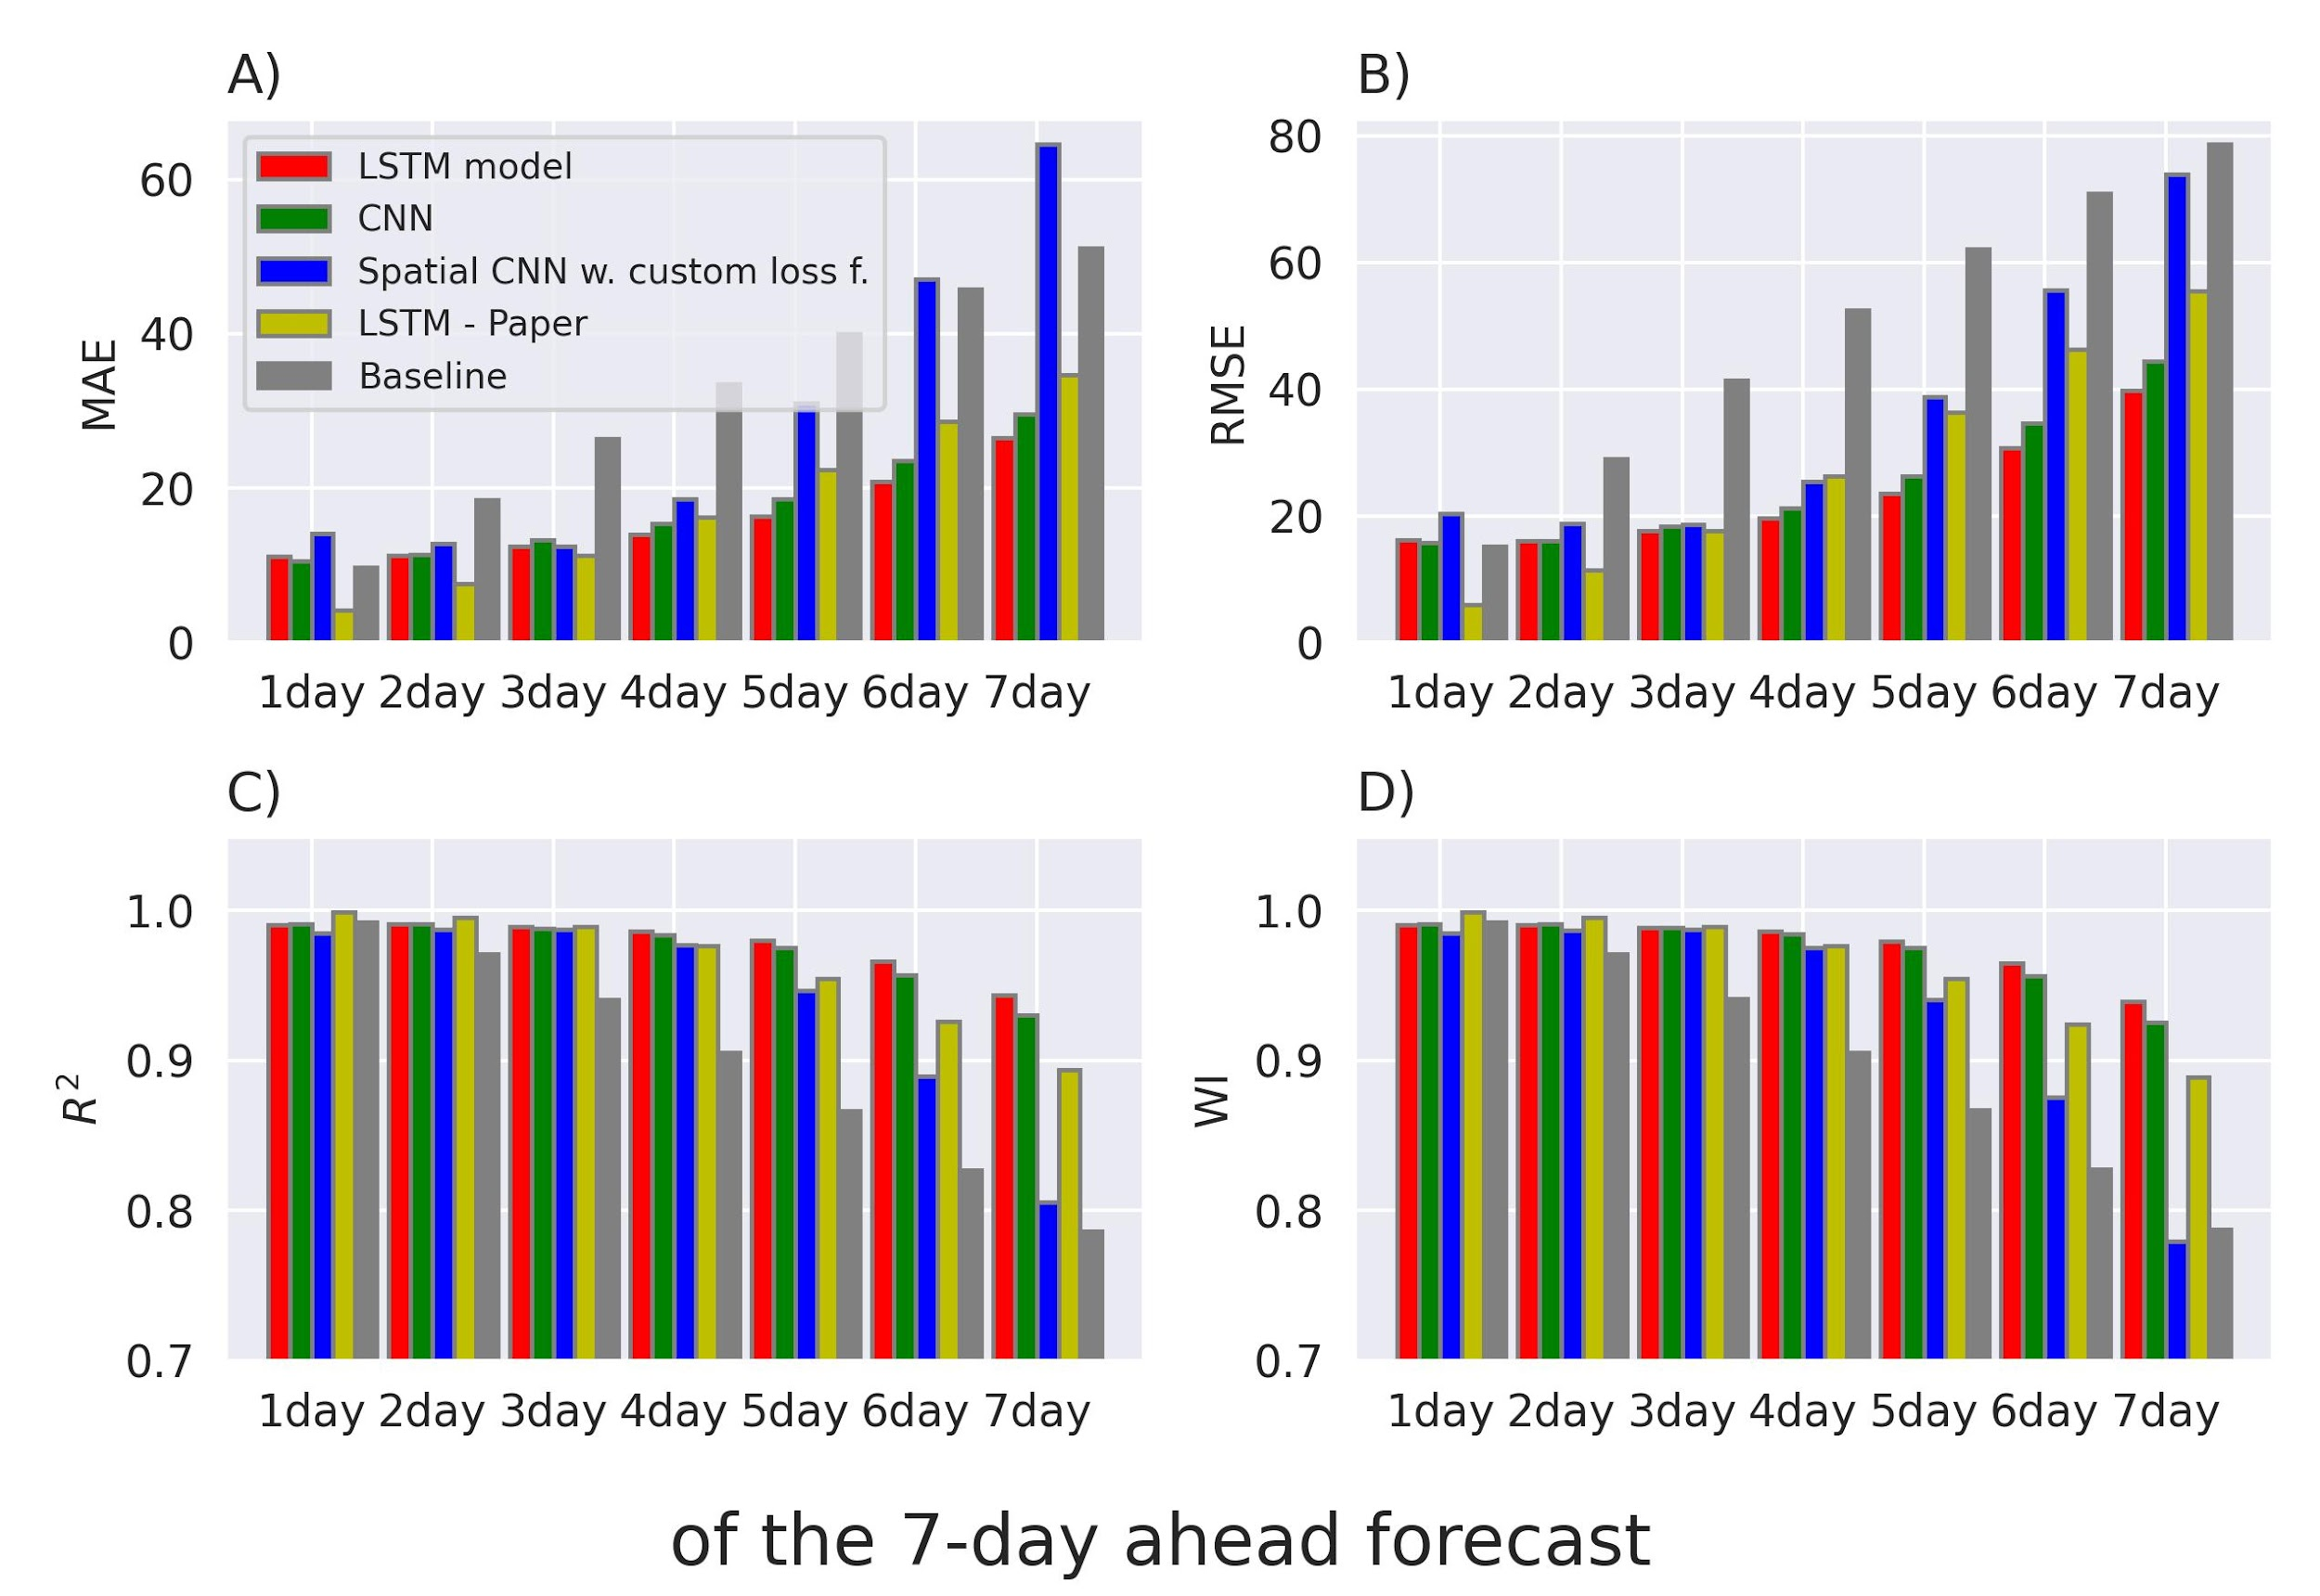
Model architectures
Results
Notes:
The result of these three networks were compared to the one in the paper and to a so called baseline model, where we predict that the water level won’t change at all. As you can see on the bar charts, the first few predictions of our model are worse than the one in the paper, but they are better for the 7 days prediction in every metrics. But the average performance is not the only important metrics, because in flood situation it should predict the water level precisely.

Slide 12
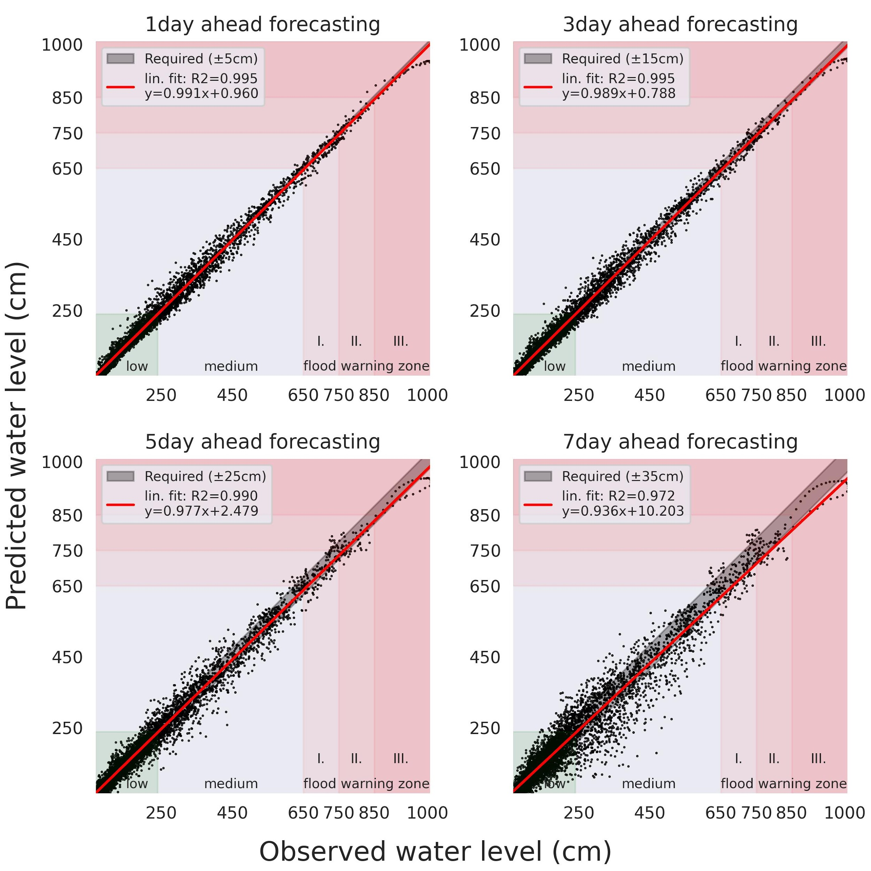
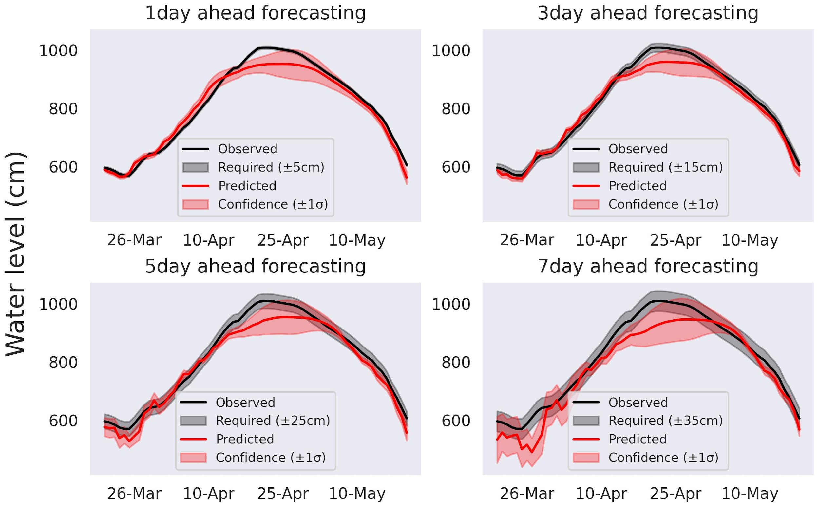
Model architectures
Results - LSTM
Notes:
On the left you can see the prediction of the LSTM model for one year interval. As you can see it doesn’t fit the gray required region in the case of the flood in 2006. In the right side the distribution of the data can be seen.

Slide 13

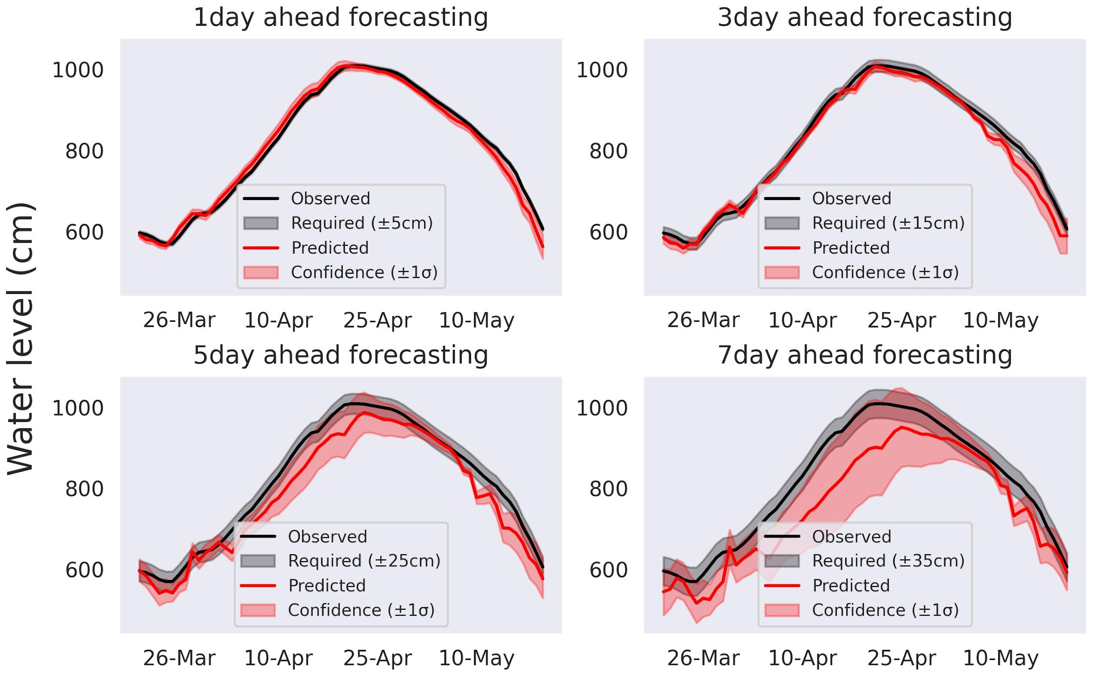
Model architectures
Results - CNN
Notes:
In the case of the CNN model the confidence interval reaches the required interval in the case of the 7 day prediction as well. But the distribution of the predicted points is larger as well.

Slide 14
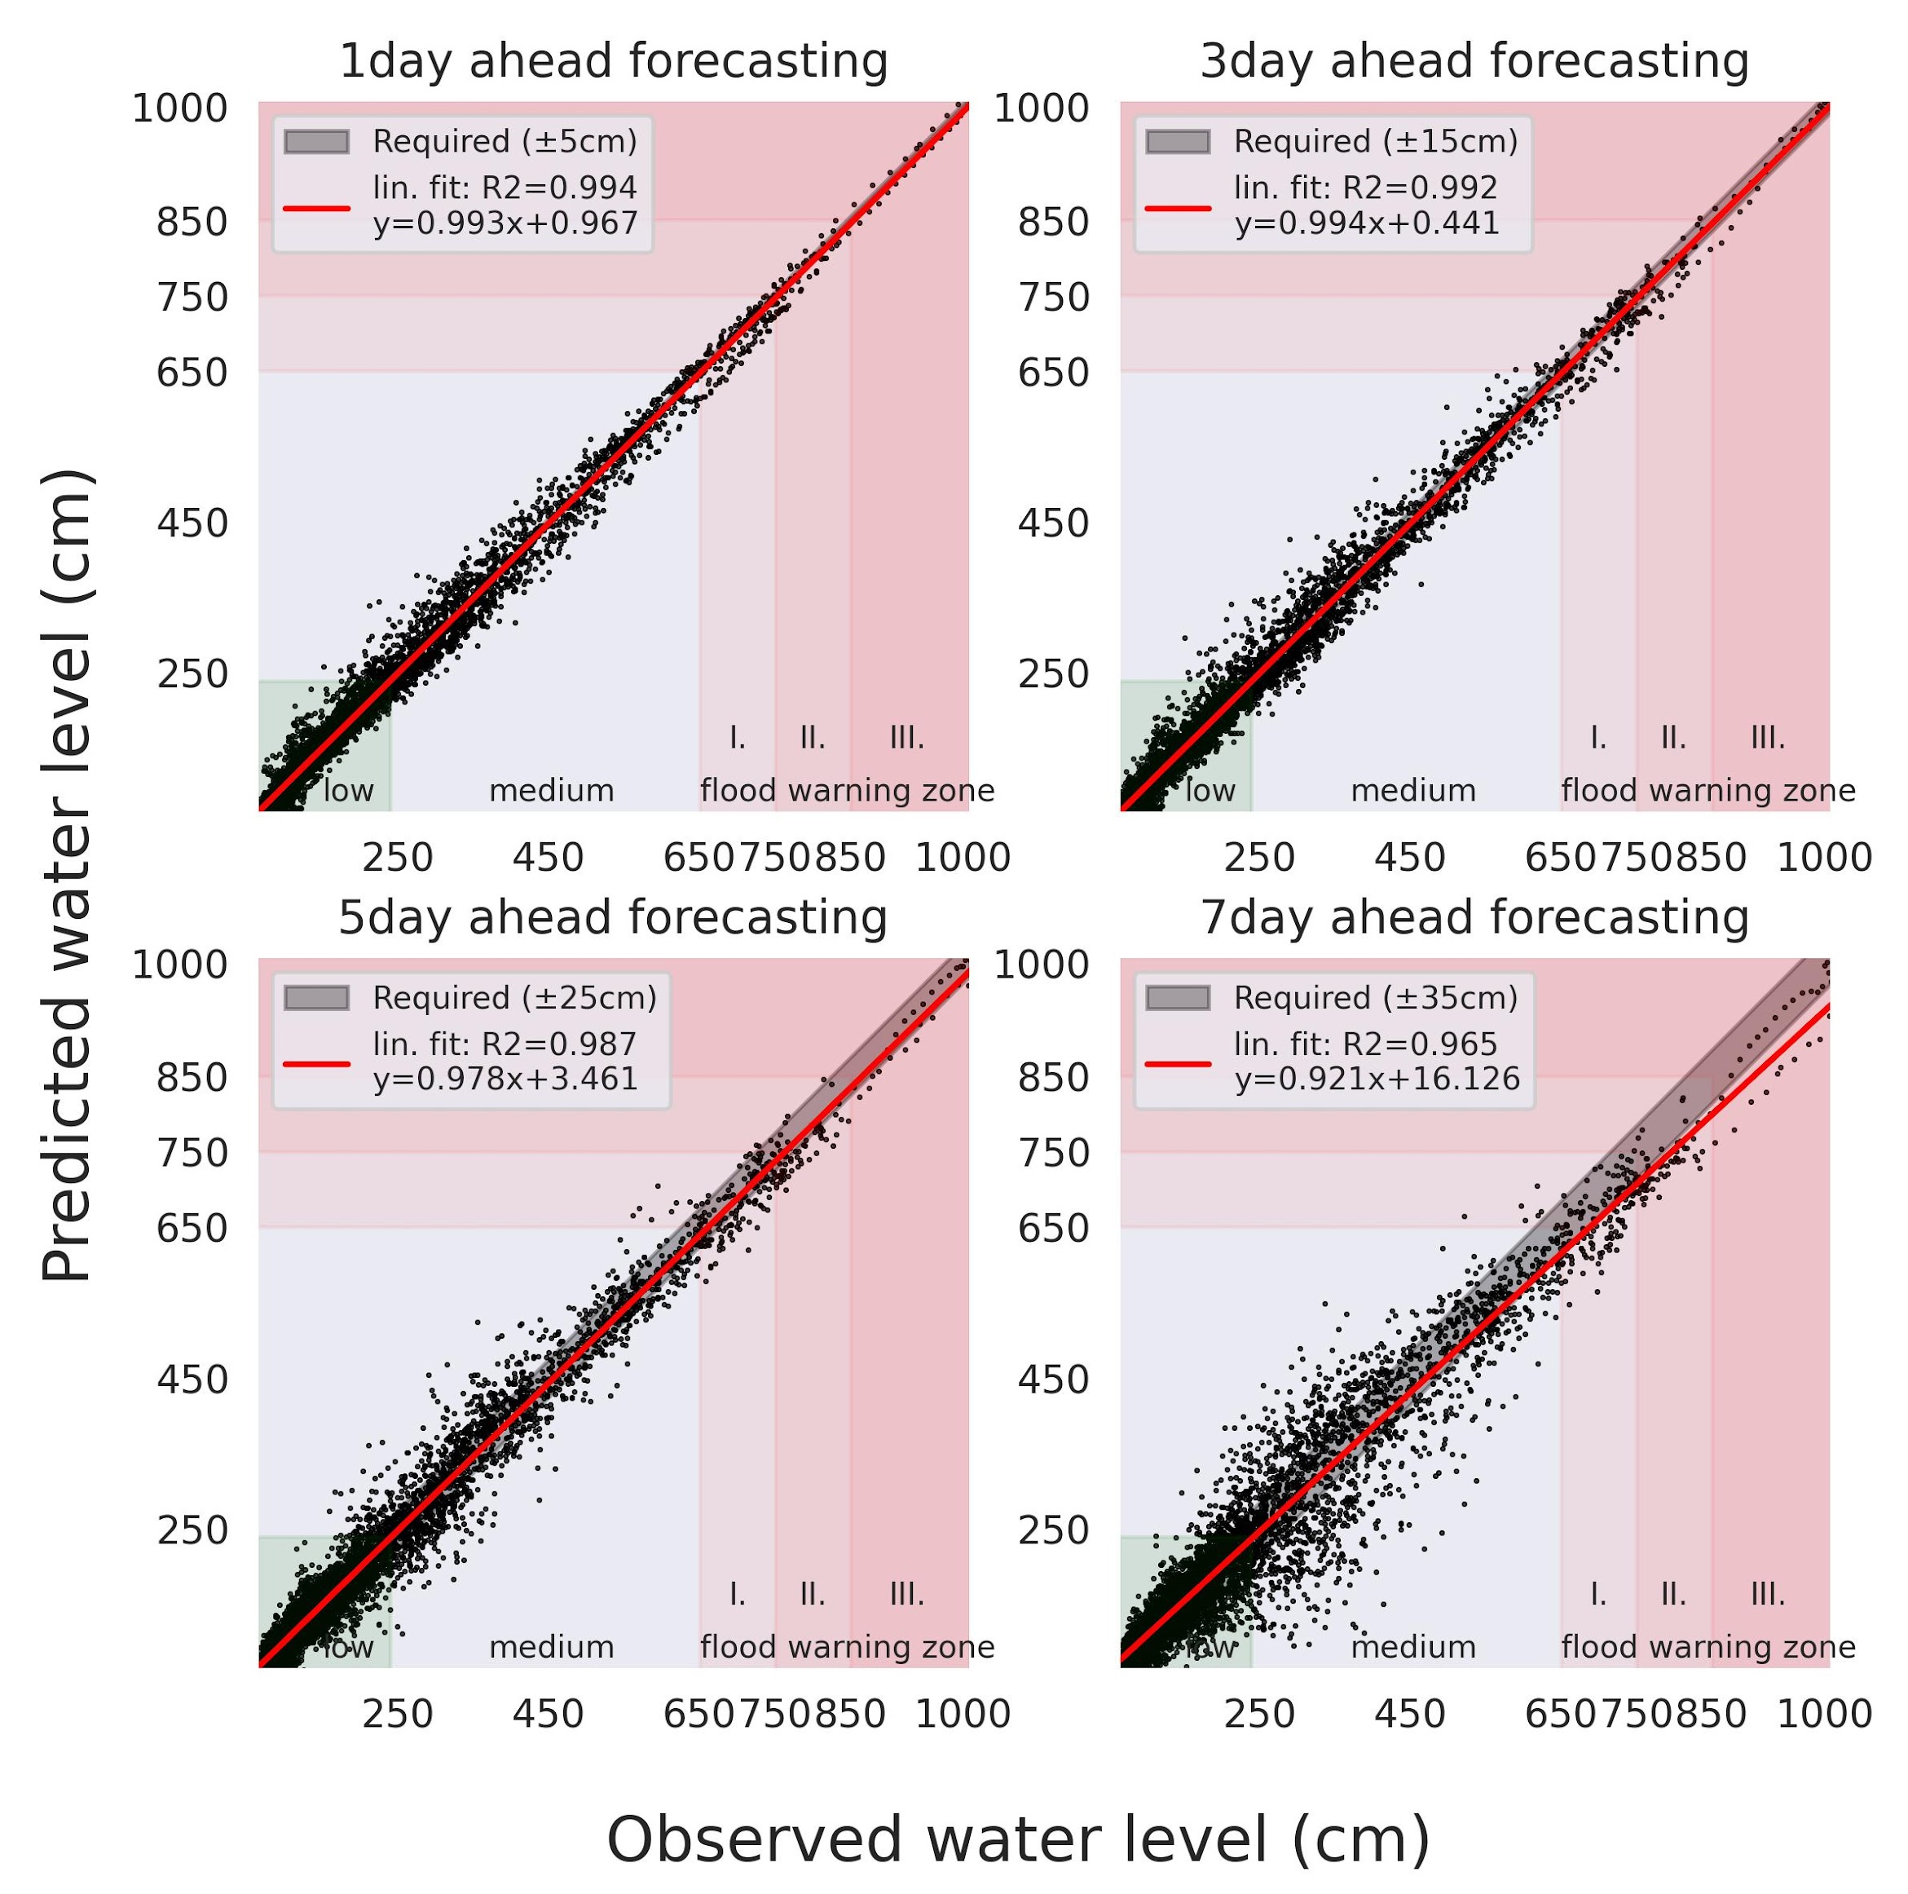
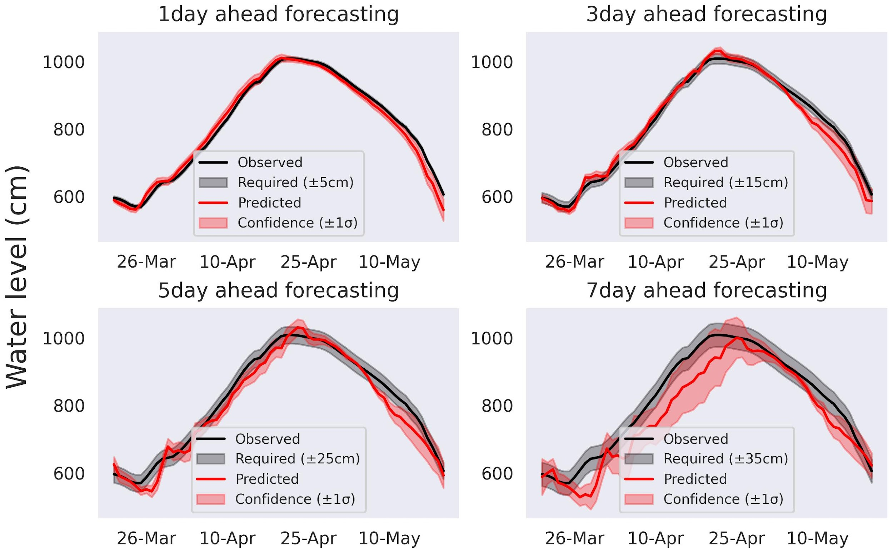
Model architectures
Results - CNN Spatial
Notes:
Using the spatial information in the case of the CNN model it also covers the given region and the distribution of the predicted points is similar. We reached only a little improvement compared to the CNN network.

Slide 15
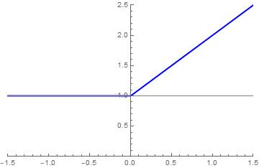
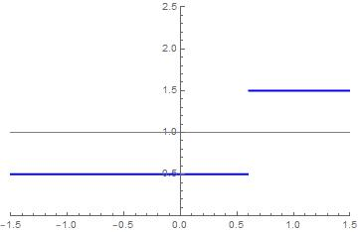
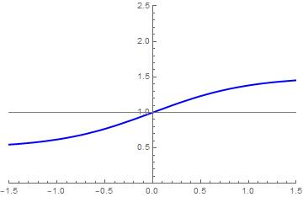
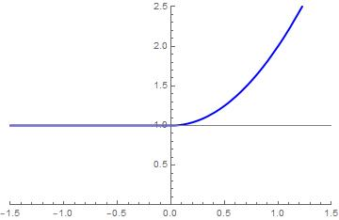
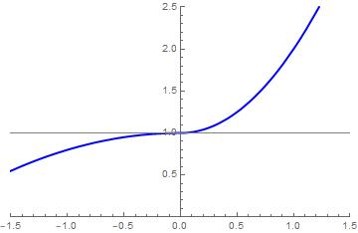
Modifying the loss function
The Idea
The coefficient for the penality
The current water level
Notes:
After seeing the results, our opinion was, that none of the models is predicting the floods accurate enough. In those important situations the accuracy is critical. Therefore we decided, that it would be a good idea, to modify on the training data in such way, that the flood and close-to-flood situations are shown to the model with higher probability.
This is basically equivalent to apply a modifier function to the loss function so it gives more penalty if the errors are big at high water level, than if the errors are big at low or medium water level. To do this there are several functions to think about:
Staircase - there is a limit, and all the datapoints which are over that are more important
Sigmoid - Its a more smooth function, but it takes more time to calculate
relu activation func - We can use something like the relu, so the penality is linear to the waterlevel at some point
relu squared - we can square the previous, so the very high water levels are even more important
make something out of polynomials - its easier to calculate, and we can tune a whole bunch of stuff
we went with the last option, but there are many options to think about, so there is way to improve in this case

Slide 16

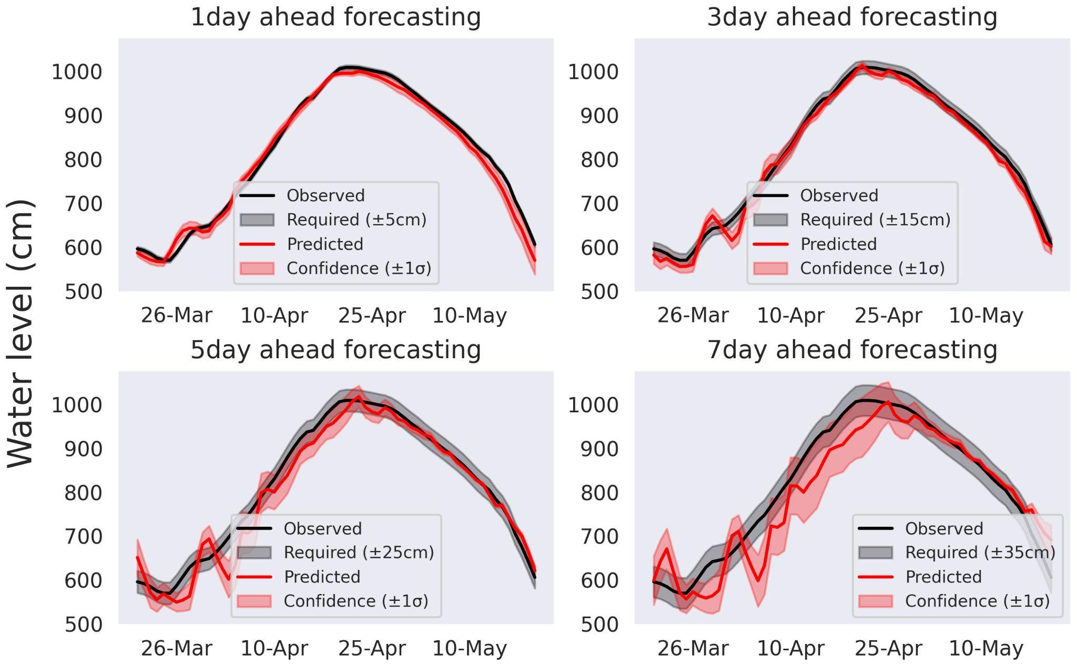
Modifying the loss function
Results with CNN
Original CNN CNN with Modified LossFunction
Notes:
There is a small comparison diagram for the CNN model without and with this modified lost function at the 2006 flood
-Its not good at average, not for everyday use
-At high water levels it isn’t bad, but there is still much room for improvement
-finetuning is not easy, because there are many functions to consider, but not many reasons to stick with one

Slide 17
Thank you for your attention!

